Slide 1
Zoning and Permitting – and what it means for you
A Presentation to the Rosemont Citizens Association
Matt Pfeiffer (129 E. Walnut Street)
May 14, 2026

Slide 2
Outline
Zoning 101 – what is zoning and why do we have it?
Legal Framework – Code of Virginia
Zoning in Rosemont – A look at the Map and Zones
Zoning Administration –Permitting and Enforcement
Other City Regulations –Local Historic Districts, Land Permitting, Building Permitting, Small Area Planning

Slide 3
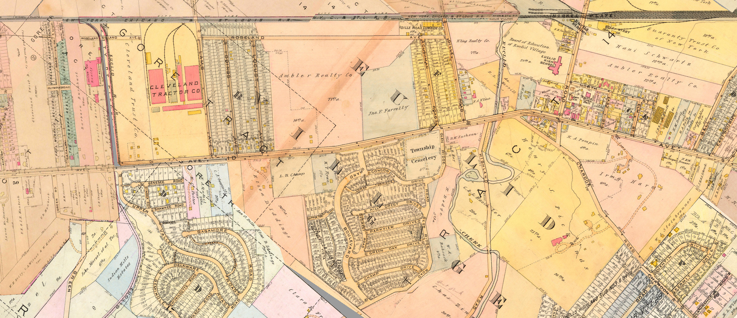
Zoning 101
What is Zoning?
Separation of land into legal districts, or zones, with different regulations on land use, building height, density and placement/coverage,
When did we start Zoning tracts of land, and why?
Zoning began to be practiced in the United States in 1901 with New York City’s Tenement House Law, and constitutionality was affirmed in the 1927 Supreme Court Case Village of Euclid, Ohio vs. Ambler Realty, Co. This early zoning was a reaction to blighted conditions caused by the rapid urbanization of the late 19th Century, and continued with the growth of the suburbs in the mid-20th Century
Are there different types of Zoning? YES!
Euclidean Zoning – traditional, single-use districts
Form-Based Codes – focuses on building form over use
Incentive Zoning – zoning as a tool to implement City priorities
What is the difference between Planning and Zoning? Planning refers to a municipality’s long-term vision for land use. Zoning refers to what is legally permitted on a tract of land
Village of Euclid, OH Zoning Map (1927)

Slide 4
Legal Framework in Commonwealth of VA
Complies with standards set forth in local Zoning Ordinance; some permitted modifications via site plan.
Zoning Enabled (Code of Virginia)
By-Right Development
Special Exception Development
Development Special Use Permit
Special Use Permits
Exceeds standards set forth in ZO. Allows for incentive zoning and conditional zoning. Requires legislative approval by City Council.
The Board of Zoning Appeals (BZA) may grant a variance for noncompliance in certain circumstances where an applicant demonstrates a hardship.
Uses permitted if considerations are met and mitigated by conditions.
Development density and height may exceed by-right standards if mitigated by conditions, and provides public benefits.

Slide 5
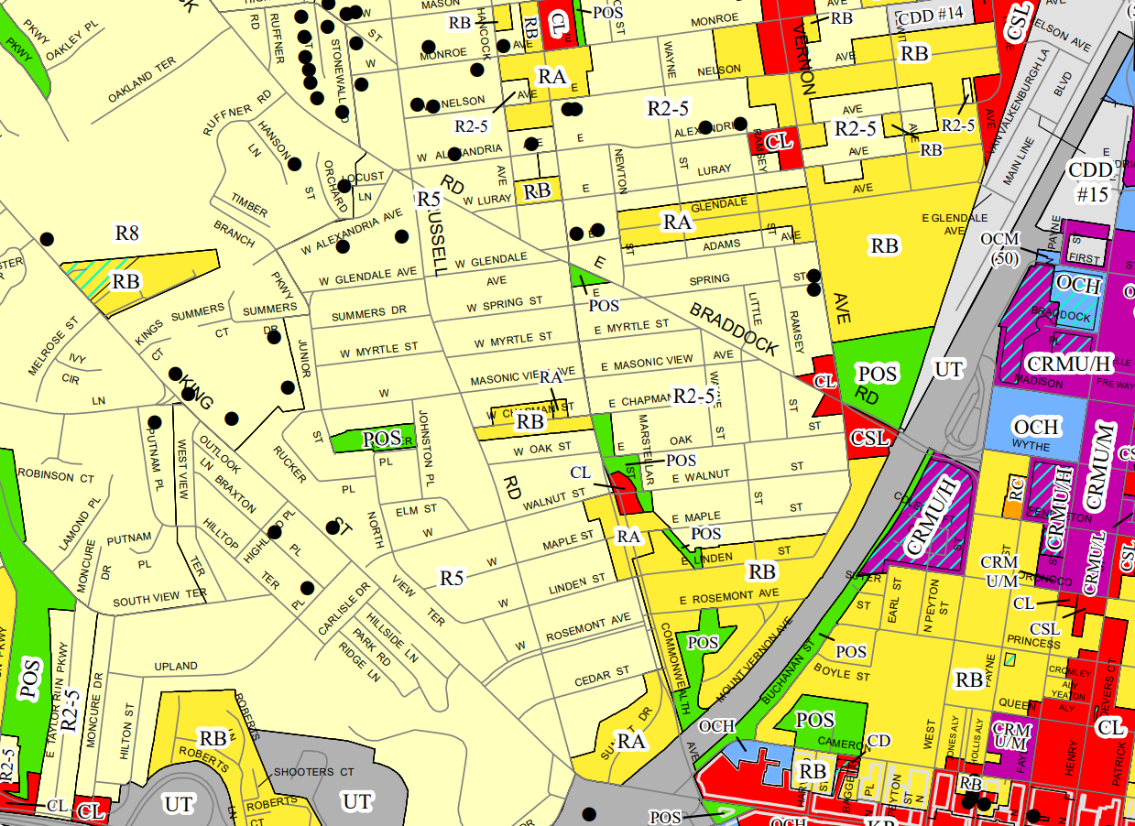
Zoning in Rosemont
RA
R-5
R2-5
POS
CL
RB

Slide 6
Zoning in Rosemont
R2-5, Residential Zone
R-5, Residential Zone
Purpose: 1 – 4-unit dwellings on 5,000 sf lots
Maximum height: 30 feet; 40 feet for churches/schools
Maximum density: 0.45 FAR
Lot, bulk and open space regulations
Special uses allowed via SUP or administrative SUP
Purpose: 1 – 4-unit dwellings on 5,000 sf lots
Maximum height: 30 feet; 40 feet for churches/schools
Maximum density: 0.45 FAR
Lot, bulk and open space regulations
Special uses allowed via SUP or administrative SUP
Major difference between R2-5 and R-5 is that R2-5 was designed to accommodate two-family dwellings and contains slightly different lot and setback regulations

Slide 7
Zoning in Rosemont
RA/Multi-Unit Zone
RB/Townhouse Zone
Purpose: multifamily, townhouse, two-and one-unit dwellings
Maximum height: 30 feet for one and two-family units; 45 feet for all other structures
Maximum density: 22 du/acre & 1,980 sf of lot area/unit & 0.75 FAR
Lot, bulk and open space regulations
Special uses allowed via SUP or Administrative SUP
Purpose: townhouse, two-and one-unit dwellings
Maximum height: 30 feet for one and two-family units; 45 feet for all other structures
Maximum density: 22 du/acre & 1,980 sf of lot area/unit & 0.75 FAR
Lot, bulk and open space regulations
Special uses allowed via SUP or Administrative SUP
Major difference between RA and RB is the allowance for multifamily uses in RA; special provisions in local historic districts

Slide 8
Zoning in Rosemont
POS Public Open Space and Community Recreation Zone
CL Commercial Low Zone
Purpose: parks
Maximum height: 30 feet
Purpose: small-scale retail and service uses
Permitted uses: residential uses, retail uses, daycare center, medical office, schools, social service uses
Maximum height: 35 feet
Maximum density: 0.75 FAR or 0.5 FAR (depending on lot size)
Lot, bulk and open space: none for nonresidential uses

Slide 9
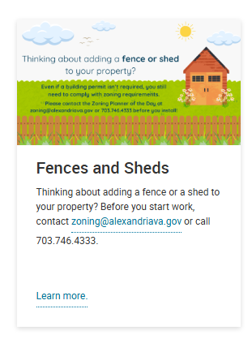
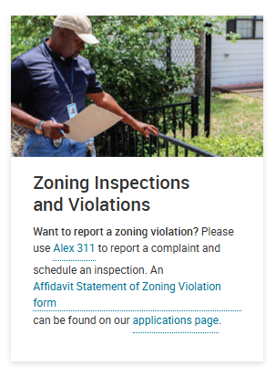
Zoning Administration
What do I do if I want to redevelop my property, build an addition, accessory structure or new fence?
Contact the Zoning Planner of the Day at pczoning@alexandriava.gov . They can give you advice prior to a building permit application.
What do I do if I think there are zoning violations in my neighborhood?
Call Alex 311 and file a complaint and schedule an inspection.

Slide 10
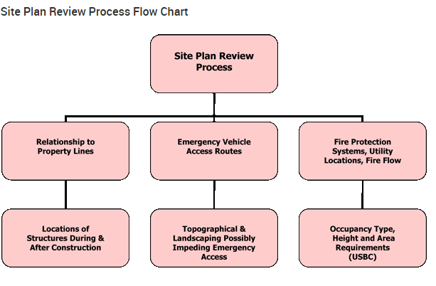
Other Regulations and Review Processes
Site and Subdivision Plans– Site Plan and Subdivision Plans are reviewed by staff and the Planning Commission. All development proposals greater than three dwelling units or 3,000 sf of GFA require a site plan. Certain development standards may be modified by site plan. Reviewed for compliance with the Chesapeake Bay Preservation Ordinance, Emergency Vehicle Access standards, Landscape Guidelines, etc.
Building Permitting – All new development must obtain a building permit, which is reviewed against the Virginia Statewide Building Code.
Local Historic Districts – The City has two local historic districts*. Any development/renovation requires the Board of Architectural Review to issue a Certificate of Appropriateness
Small Area Plans –City policies that guide land use, private development and public investment. These plans are not regulatory.
Special Use Permits – Development Special Use Permits (DSUP), Special Use Permits (SUP), and Administrative SUP’s.
* Old and Historic Alexandria District & Parker-Gray District

Slide 11
Thank you!

Slide 12
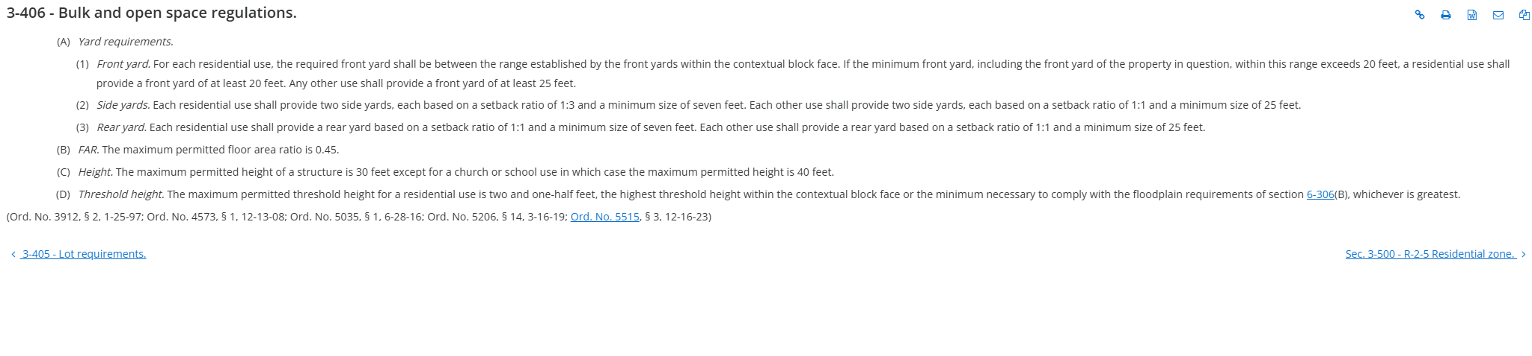
R-5 Bulk and Open Space Regulations

Slide 13
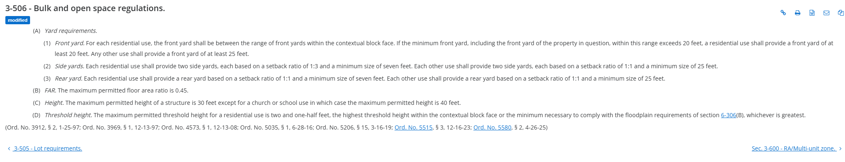
R2-5 Bulk and Open Space Regulations

Slide 14
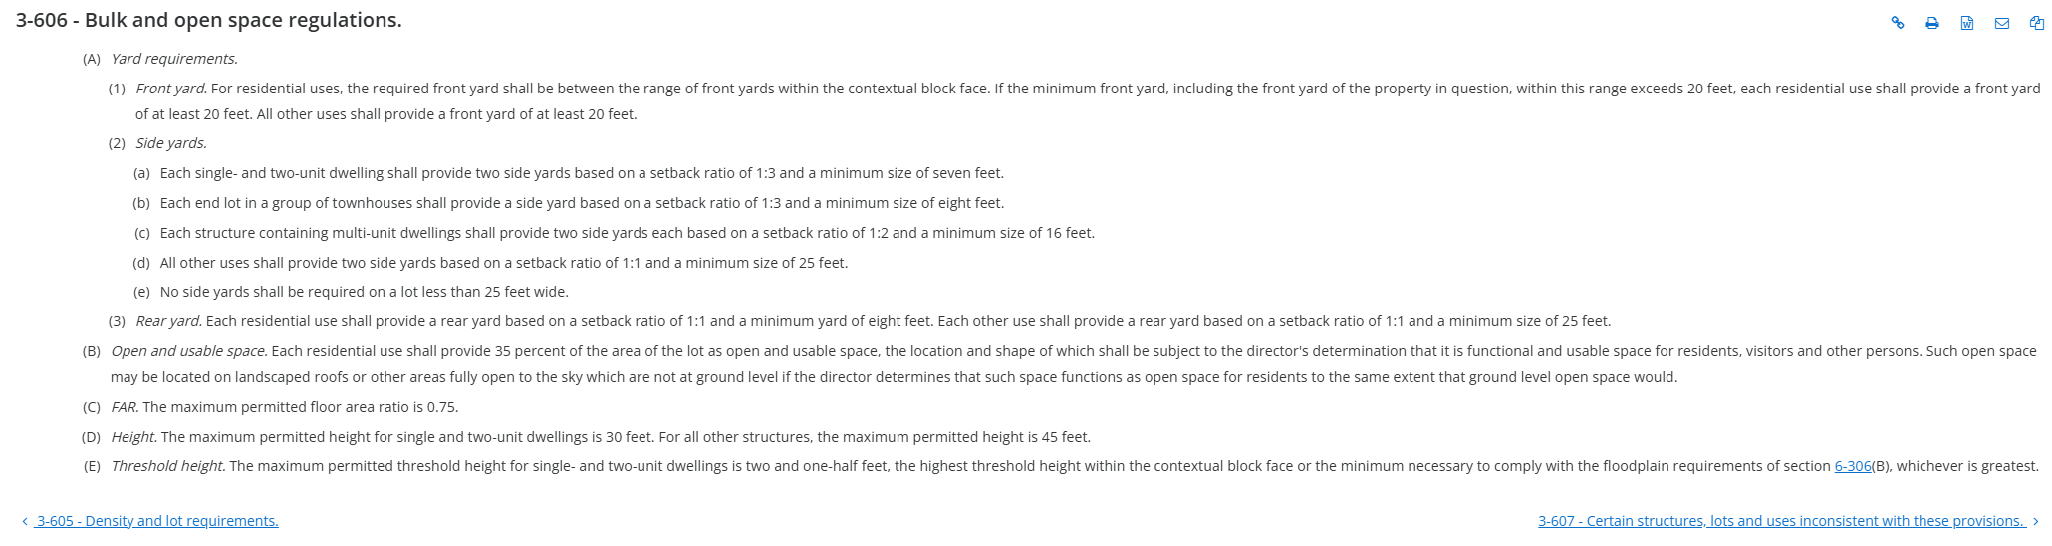
RA Bulk and Open Space Regulations

Slide 15
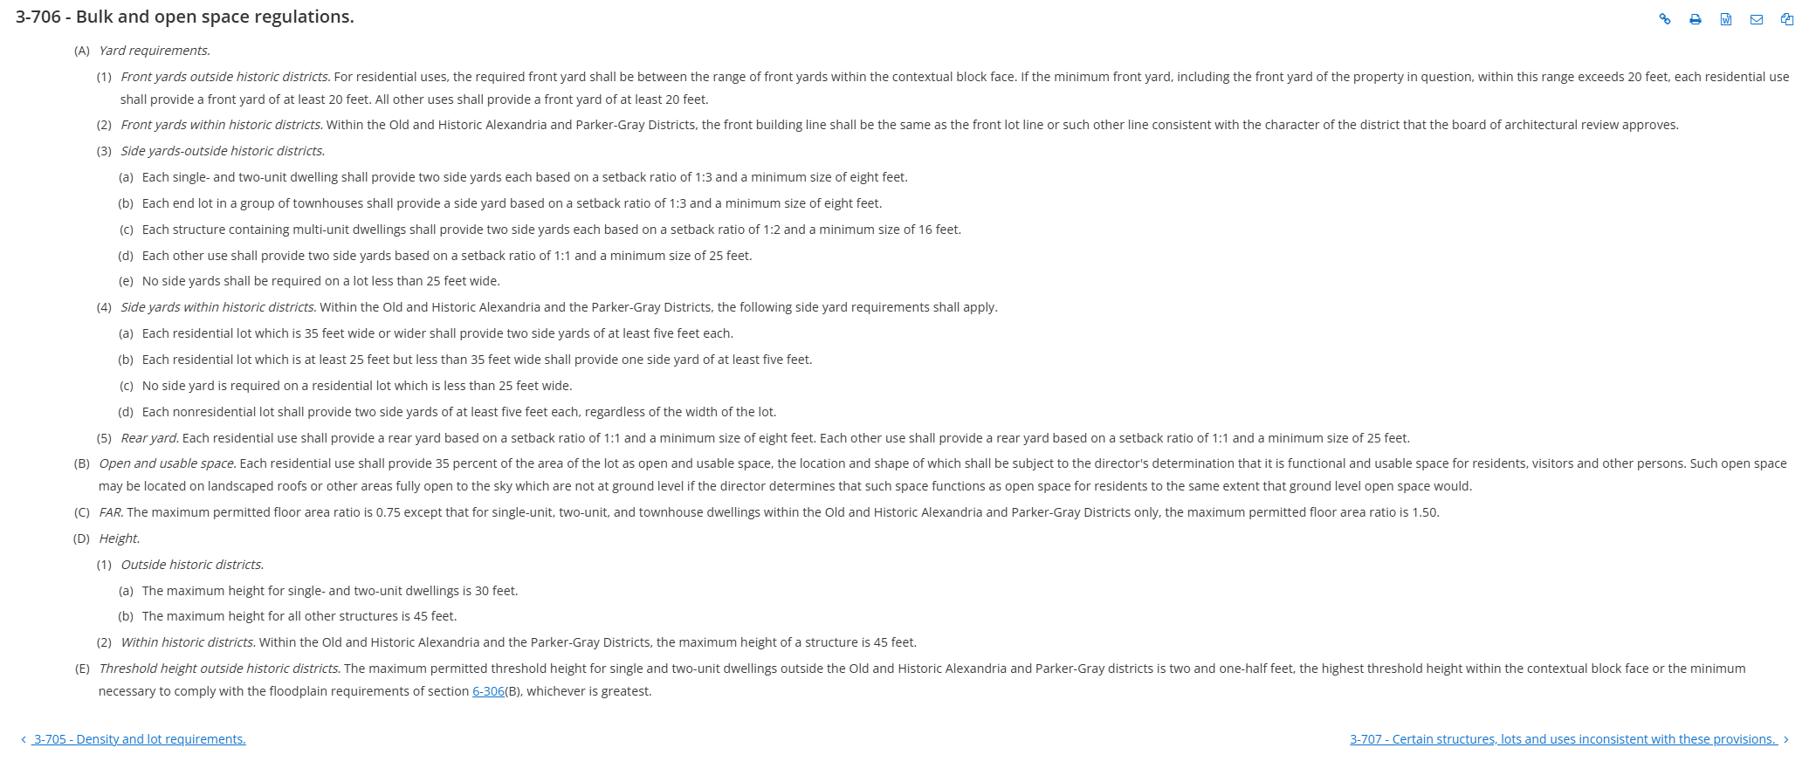
RB Bulk and Open Space Regulations

